Slide 1



ENVIRONMENTAL HEALTH INTERVENTIONS FOR PREVENTATIVE PRACTICE IN CLINICAL SETTINGS
BY MISS A. BUKHOSINI
GROWING KWAZULU-NATAL TOGETHER

Slide 2

GROWING KWAZULU-NATAL TOGETHER
LEARNING OUTCOMES
Define environmental health within clinical settings.
Describing the role of an EHP in public health facilities
Core preventative interventions of EHPs in public health facilities
2

Slide 3
GROWING KWAZULU-NATAL TOGETHER
INTRODUCTION
Environmental health is equals to the conditions in the clinical environment that influence patients and staff wellbeing in the clinical setting
Environmental health is a vital component that focuses on preventative practice which aims to eliminate or reduce environmental risks in the clinical setting
It focuses on identifying and mitigating environmental factors that can adversely affect health
Integration of environmental health into clinical setting enhances patients' safety, infection prevention and sustainable healthcare delivery.
3

Slide 4
GROWING KWAZULU-NATAL TOGETHER
THE ROLE OF AN EHP IN CLINICAL PRACTICE
Ensure safety and hygiene in a healthcare environment.
Supports clinical programs in the healthcare facility
Collaboration with public health(form part of various committees in a healthcare facility)
Monitor compliance with environmental health regulations and standards
Conducts EH awareness & trainings
Conduct audits to monitor compliance
Develop Standards operating procedures(SOPs) and guidelines relating to Environmental Health
4

Slide 5
GROWING KWAZULU-NATAL TOGETHER
ENVIRONMENTAL HEALTH INTERVENTIONS
Waste Management
- Safe and proper waste segregation, storage,treatment
and disposal of healthcare waste
- Prevention of disease transmission through
contaminated waste
Water Quality Monitoring
- Ensuring potable water supply within healthcare facilities.
- Routine testing for microbial and chemical contaminants
Sanitation and hygiene
- Maintenance of clean ablution facilities and
handwashing stations
5

Slide 6
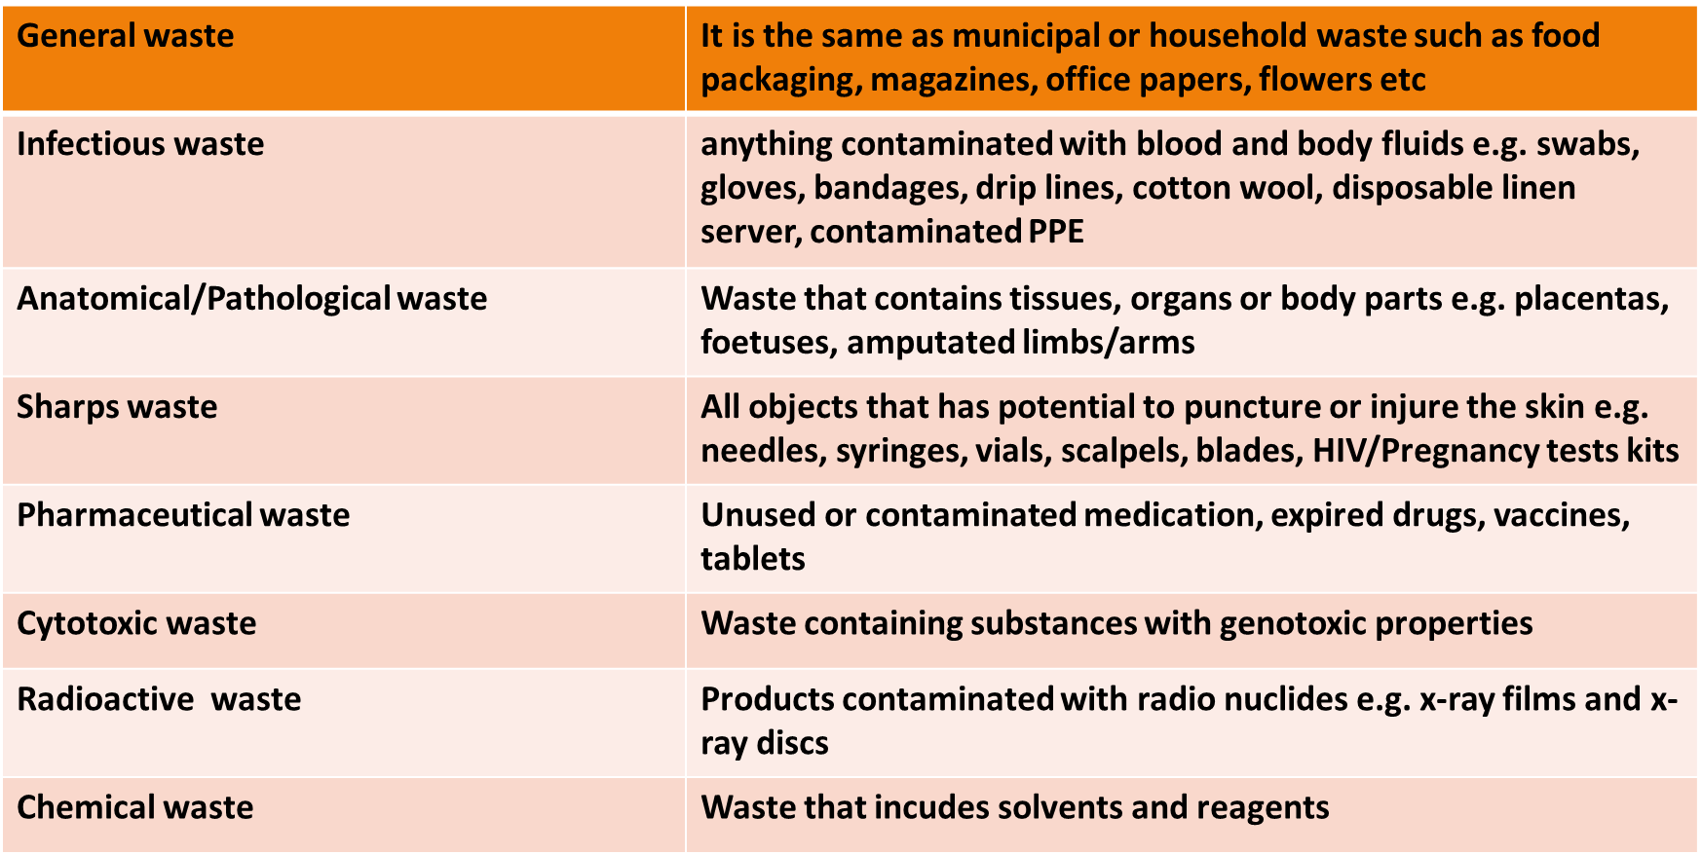

HEALTHCARE WASTE CATERGORIES

Slide 7
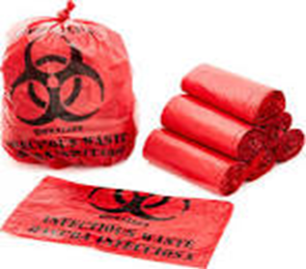
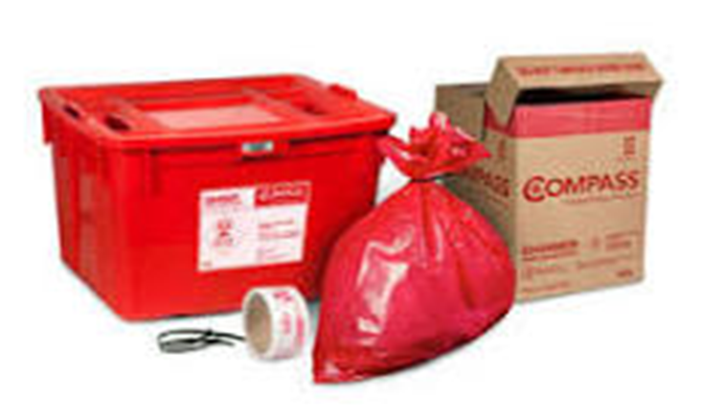
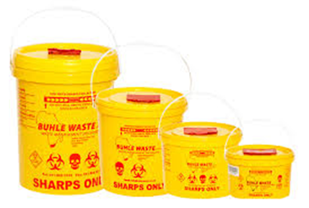
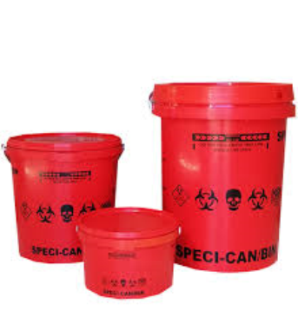
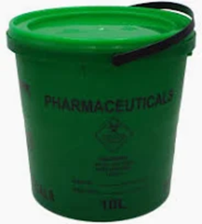
HEALTHCARE WASTE COULOUR CODES

Slide 8



Slide 9
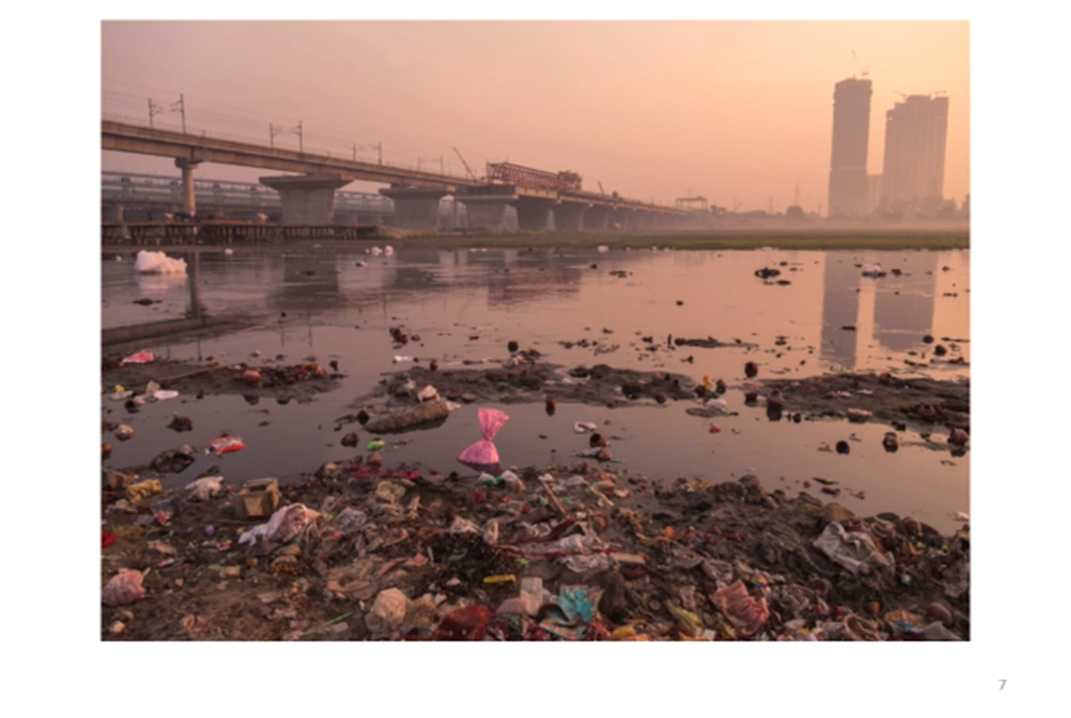

Slide 10
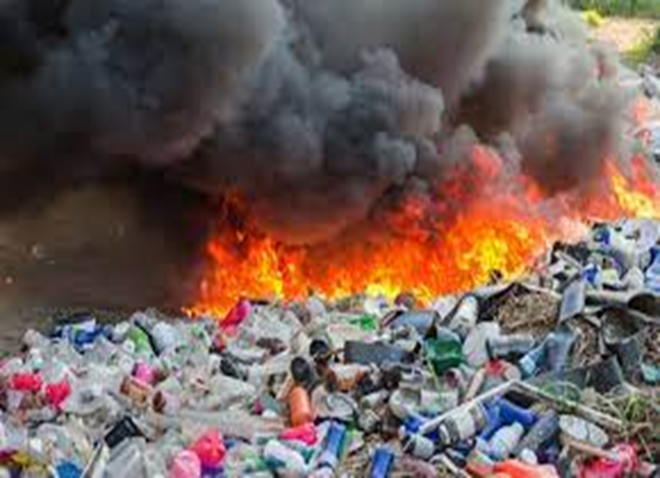

Slide 11
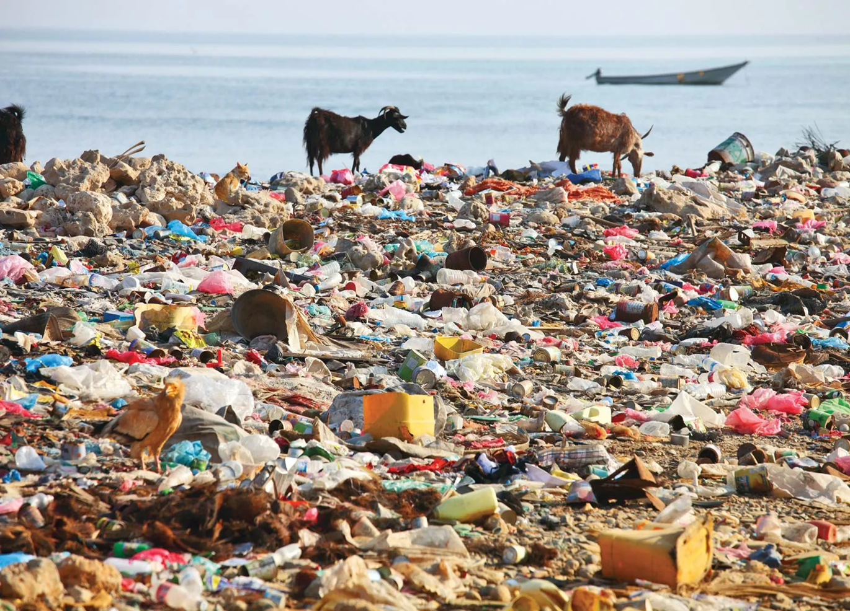

Slide 12
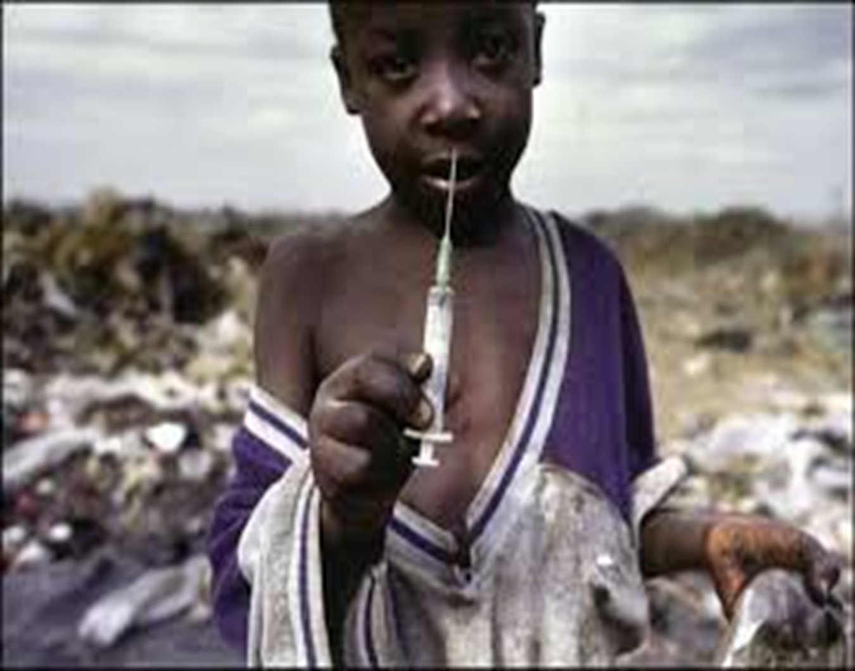

Slide 13
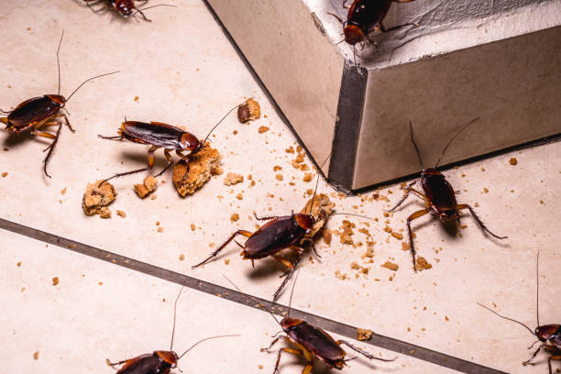
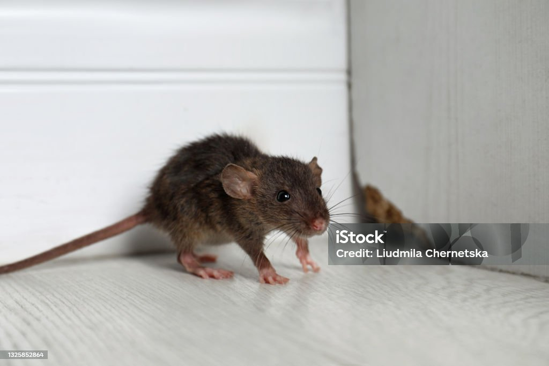
GROWING KWAZULU-NATAL TOGETHER
ENVIRONMENTAL HEALTH INTERVENTIONS
Vector control monitoring
Pest control & vector surveillance to prevent the spread of diseases
13

Slide 14


ENVIRONMENTAL HEALTH INTERVENTIONS
Food safety
Monitoring hospital kitchens and food service areas to prevent foodborne illnesses

Slide 15
CONCLUSION
Environmental health in a healthcare setting is essential for preventing infections, protecting patients and staff and ensuring a safe, clean and supportive healing environment which supports wellbeing of everyone in a healthcare setting.

Slide 16


THANK YOU

